Slide 1
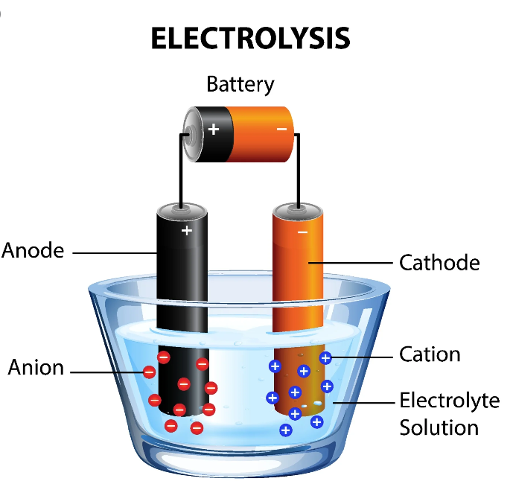
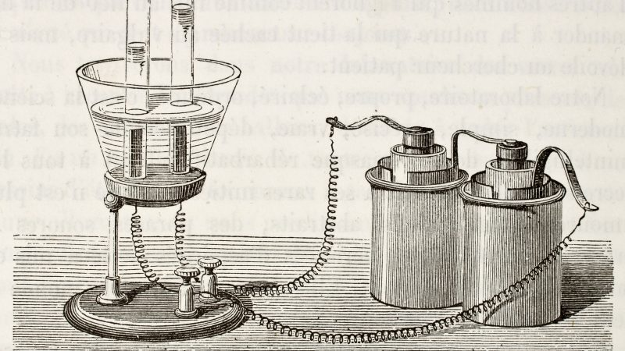
Electrolysis
Mr Dhue
(with slight modification)

Slide 2
Outline
From your syllabus:
Science Understanding
electrolytic cells use an external electrical potential difference to provide the energy to allow a non-spontaneous redox reaction to occur
describe the use of electrolysis in electrolytic refining, including for purification of copper, and metal electroplating, including for silver

Slide 3
Introduction
In a voltaic cell, a spontaneous chemical reaction takes place in which stored chemical energy is converted into electrical energy.
The cell develops an EMF which depends on the particular oxidation and reduction reactions at the electrodes and the concentration of the electrolyte solution.

Slide 4
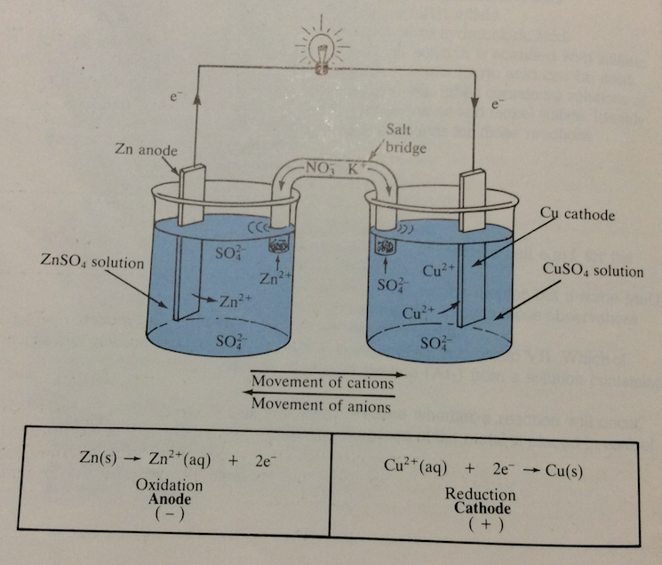
Remember the Daniell Cell ?

Slide 5
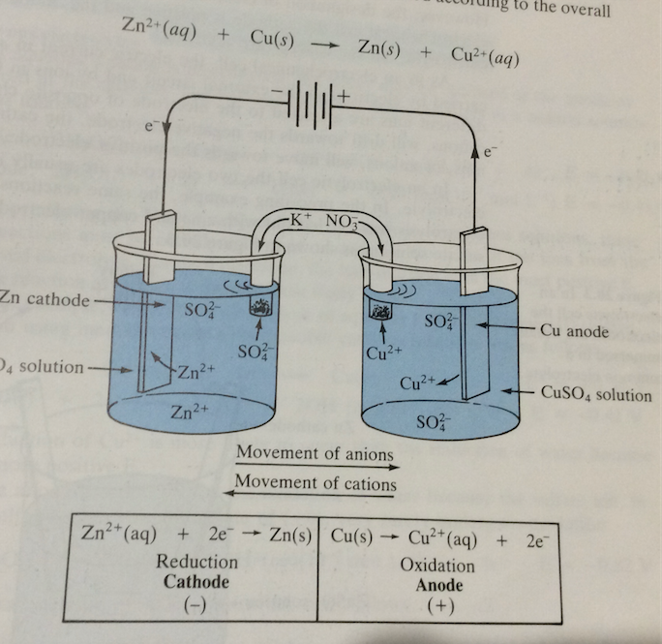
What would happen to place a battery in the external circuit in opposite polarity to that of the cell ?

Slide 6
If the applied voltage is at least 1.10 V the electrode reactions are reversed and zinc and copper (II) ions will be formed by the cell.
Note the half cells have swapped from anode to cathode (and vis versa) as the oxidation and reduction processes have swapped.
This reaction is not spontaneous and converts electrical energy for the reaction to proceed.
This process is called electrolysis
An electrochemical cell that electrolysis occurs is called an electrolytic cell.

Slide 7
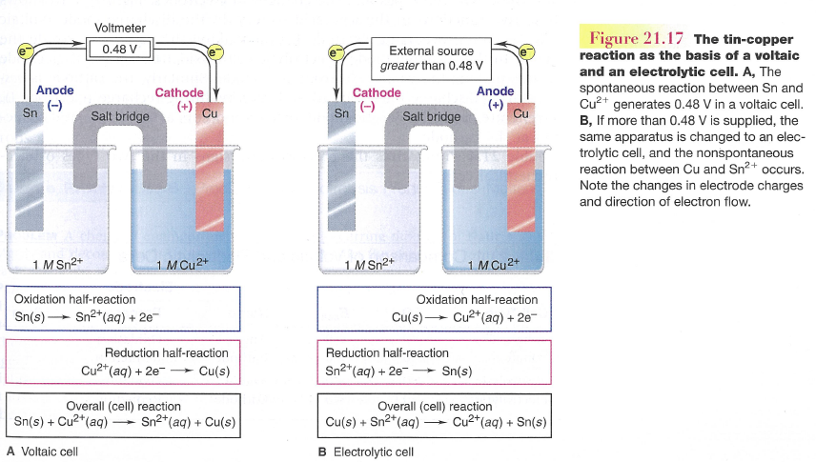
Comparison: galvanic vs electrolytic

Slide 8
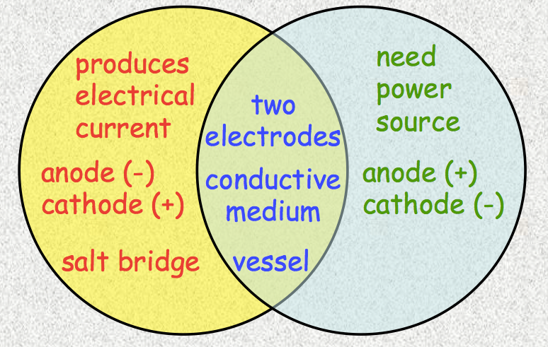
The identification of anode (oxidation) and cathode (reduction) is the same for both galvanic and electrolytic cells.
The polarity for the anode and cathode is different for galvanic and electrolytic cells

Slide 9
Two types of electrochemical cells
Voltaic Cell (or Galvanic Cell) | Electrolytic Cell
A spontaneous reaction to generate electrical energy | Uses electrical energy to drive a non-spontaneous reaction
E_{P} reactants > E_{P} products | Electrical energy converts lower E_{P} reactants to higher energy products
Can do work on the surroundings. | Work is done on the reacting system
Eg Batteries | Eg metal plating
Voltaic Cell | Electrolytic Cell
Anode (-ve) Cathode (+ve) | Anode (+ve) Cathode (-ve)

Slide 10
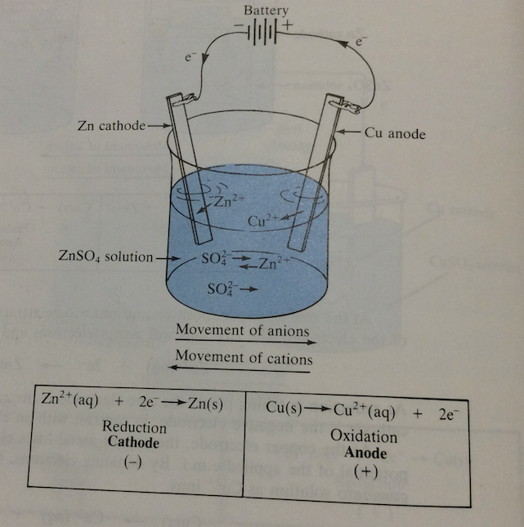
Electrolytic cells can have both electrodes immersed in the same electrolyte

Slide 11
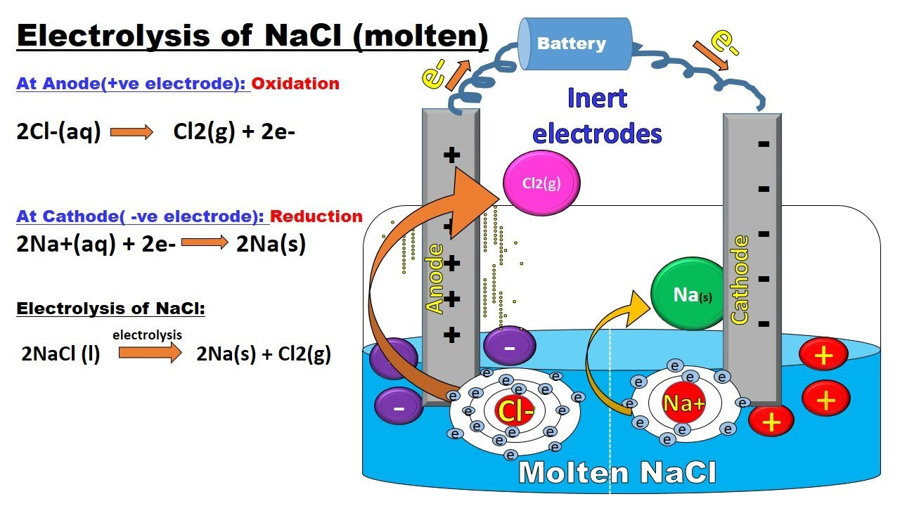
Electrolysis of molten salts
Uses a pair of inert electrodes (e.g platinum electrodes)
The electrodes are dipped into the molten salt and are connected to a DC electric power supply

Slide 12
Electrolysis of molten salts
Summary
The product at each electrode is simple if the molten salt is pure.
The electrolyte is the molten salt itself.
The cation will be reduced and the anion will be oxidised.
This is used industrially to produce active metals such as Na, Ca and Mg as well as halogens Cl₂ and Br₂

Slide 13
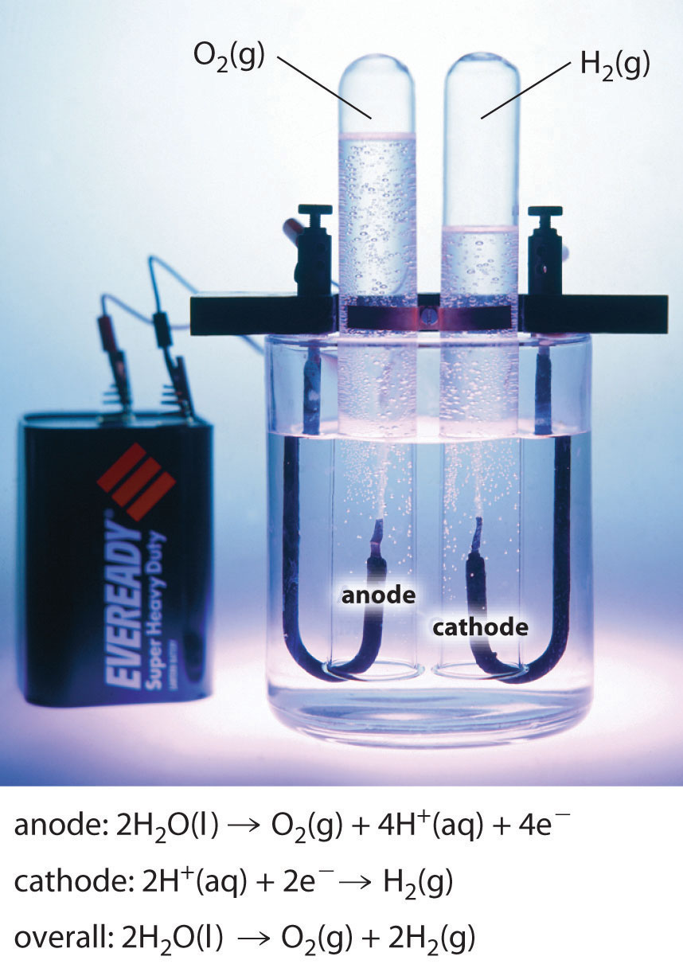
Electrolysis of an aqueous solution
It is more difficult to predict the outcome for electrolysis in aqueous solutions as the water may be oxidised and reduced preferentially
Likewise, if you use reactive electrodes they might preferentially react

Slide 14
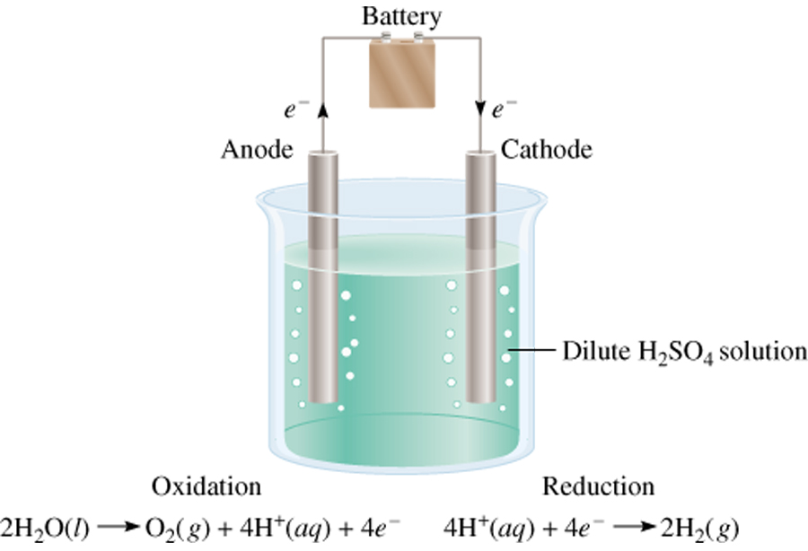
Electrolysis of an aqueous solution
Pure water is difficult to electrolyse because there are very few ions present to carry a current [H⁺] = [OH⁻] = 10⁻⁷ molL⁻¹
If a small amount of a non-reacting salt is added (or a few drops of conc H₂SO₄) the process occurs rapidly.

Slide 15
Electrolysis of an aqueous solution
Changes in these cells can be inferred from the observations:
If water is oxidised then a colourless gas is formed at the anode and the solution pH falls in the vicinity of the anode.
Anode reaction: 2H₂O_{(l)} → O_{2(g)} + 4H⁺_{(aq)} + 4e⁻
If water is reduced then a colourless gas is formed at the cathode and the pH rises near the cathode.
Cathode reaction: 2H₂O_{(l)} + 2e⁻ → H_{2(g)} + 2OH⁻_{(aq)}
If metallic electrode is oxidised than the anode will dissolve (reduce is size)

Slide 16
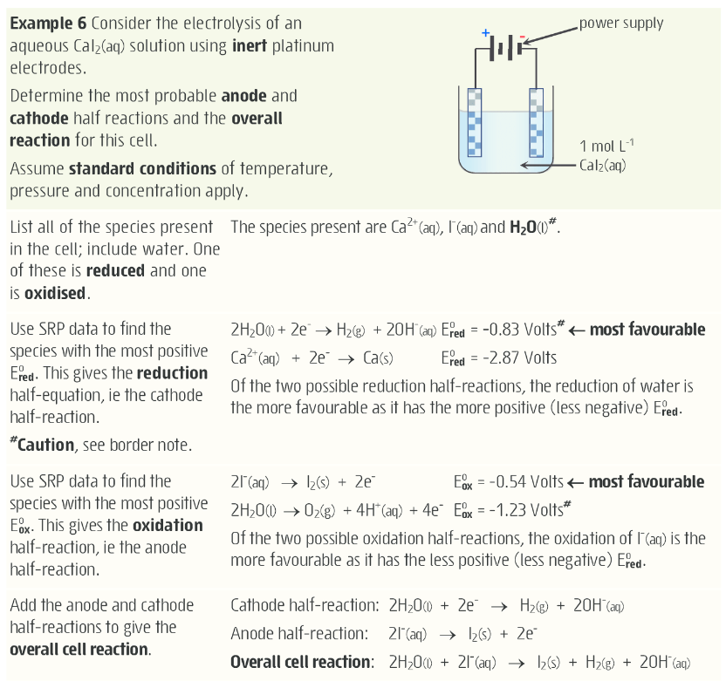
Electrolysis of an aqueous solution
*Predictions using the SRP table are limited as most electrolytic cells are not at standard conditions*

Slide 17
Types of electrolysis reactions
Electrolytic cells are often used to decompose compounds into elements and have important industrial importance. Eg Al, Cl₂, Cu, Na
Can be used to purify elements as well as metal plate items. Eg Au refining, Cr plating.
Predicting products depends on nature of electrolysis reaction, such as molten or aqueous.

Slide 18
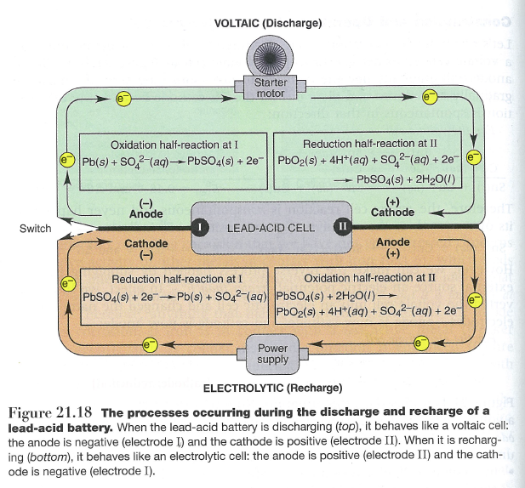
The Lead acid accumulator (aka car battery)

Slide 19
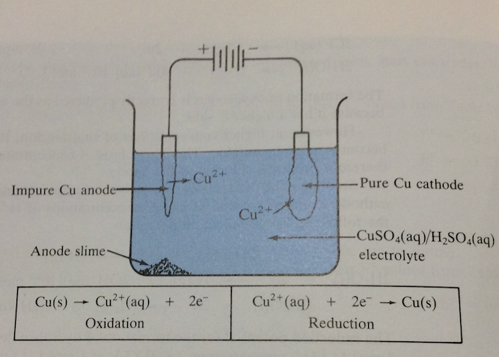
Electrorefining
Notes:
Get high purity easy to achieve, more reactive metals are oxidised but stay in the solution. Also used for gold.

Slide 20
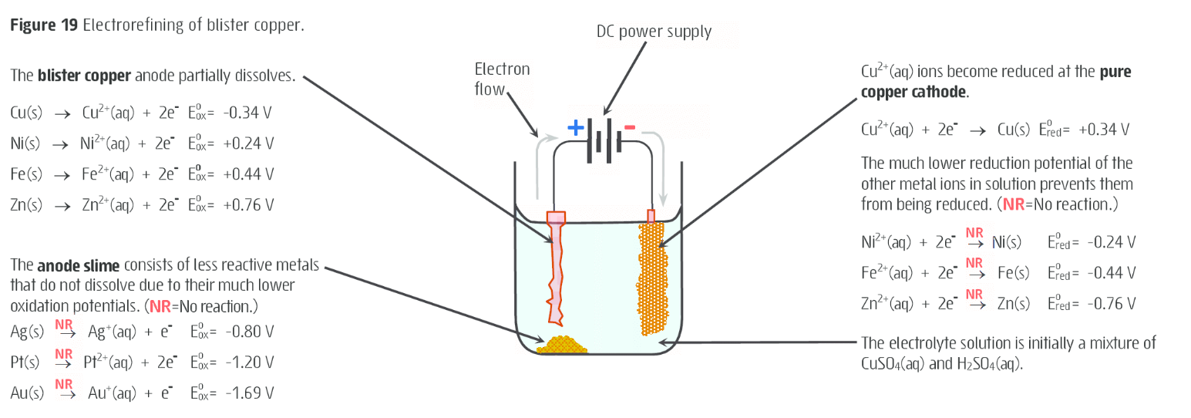
Electrorefining
Keeping the voltage low allows for the separation of copper from various metal impurities

Slide 21
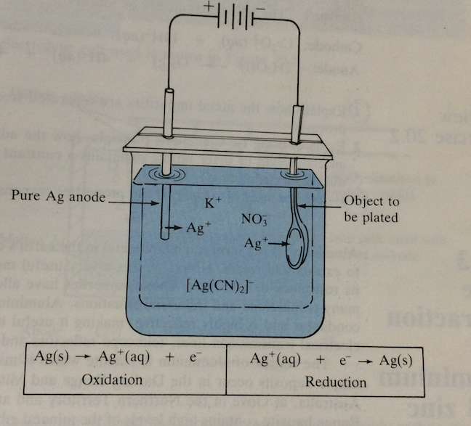
Electroplating
Notes:
Improve appearance Ag plating spoons etc, reduce corrosion eg Cr plating junk jewelrey

Slide 22
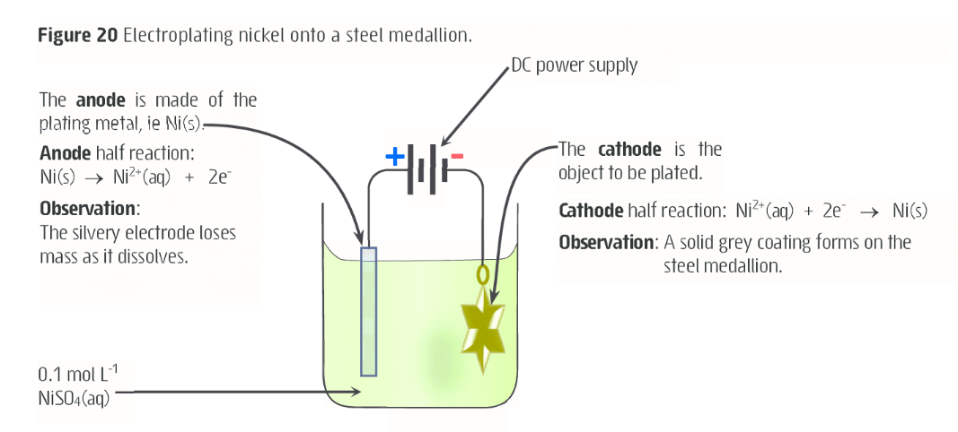
Electroplating

Slide 23
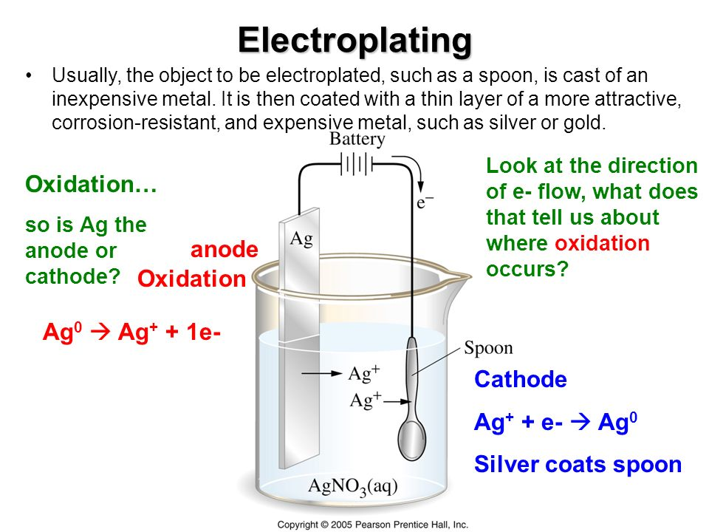
Electroplating

